Slide 1
Computer Vision
Part 1: Deep Dream and Style Transfer
ADF – Start 08:30

Slide 2

Agenda
Part 1: Deep Dream and Style Transfer
Part 2: Variational AutoEncoder
Part 3: Generative Adversarial Network
Computer Vision

Slide 3
Recap Last Week
ConvNet works as a Feature Extraction or Dimensionality Reduction
ConvNet did not produce a random decision
ConvNet forms low level features to more complex features at the deeper layers
We can use backpropagation to visualize filter
We can use backpropagation to generate image that maximize class score
Computer Vision

Slide 4
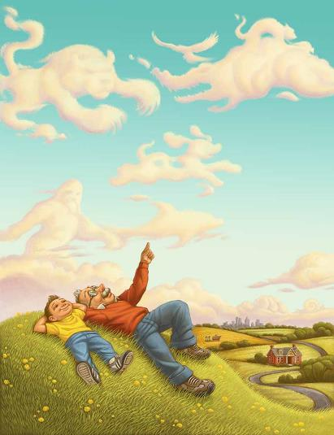
Deep Dream
Computer Vision

Slide 5
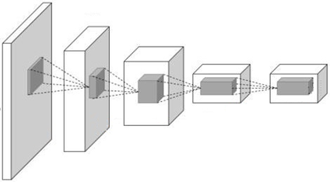
Deep Dream: Amplify existing features
Rather than synthesizing an image to maximize a specific neuron,
Instead try to amplify the neuron activations at some layer in the network
Computer Vision

Slide 6
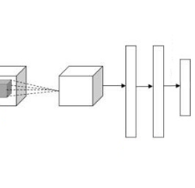
Deep Dream: Amplify existing features
Choose a layer
Forward pass image to selected layer
Set gradient equal to its activation
Computer Vision

Slide 7

Deep Dream: Amplify existing features
gradient input
Backprop to image, Do a small “image update”
Jitter (blur) the image
Repeat until converge
Computer Vision

Slide 8
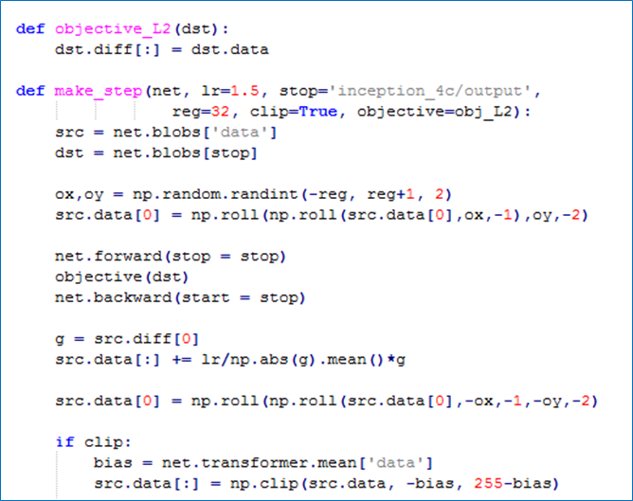
DeepDream: set dx = x
Set which layer to dream
Jitter regularizer
Image update
Clip pixel values
Computer Vision

Slide 9
Computer Vision
Notes:
Amplified the features that maximally activated in the network

Slide 10
Computer Vision

Slide 11
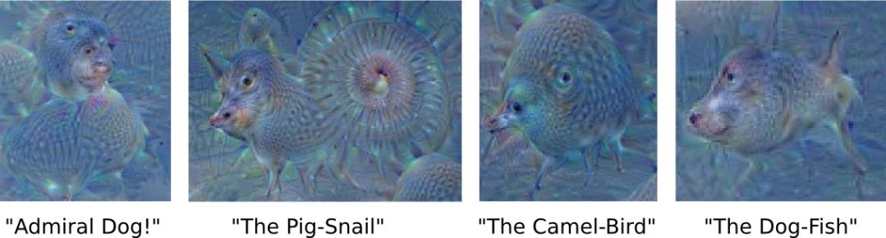
Computer Vision
Notes:
Amplified the features that maximally activated in the network

Slide 12
Deep Dream: Amplify existing features
DeepDream modifies the image in a way that “boosts” all activations, at any layer
this creates a feedback loop: e.g. any slightly detected dog face will be made more and more dog like over time
Computer Vision

Slide 13
Image Reconstruction
Computer Vision

Slide 14
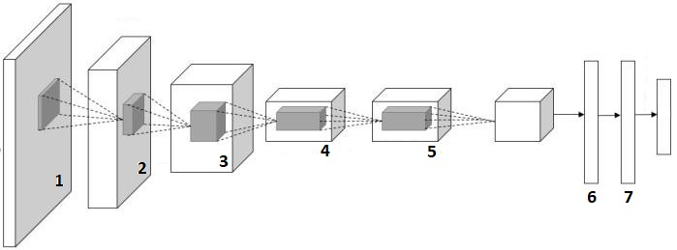
"FC7 Feature Code"
Some may think to only store the feature, and not the raw image itself
Can we restore the image from the code?
Computer Vision

Slide 15
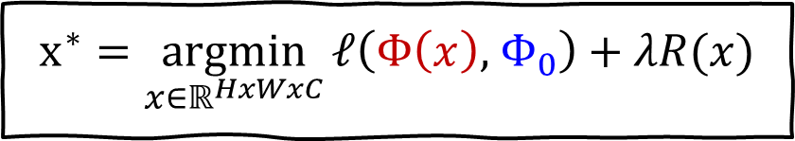
Reconstruct the original image
Given a CNN code (FC7 features)
Find a new image that:
Best matches to the feature (Its FC7code is similar to a given code)
It "looks natural" (image prior regularization)
$$x^{∗}=\underset{x∈ℝ^{HxWxC}}{argmin}{ℓ\left(Φ\left(x\right), { Φ}_{0}\right)+λR(x)}$$
Features of new image
Given feature vector
[Understanding Deep Image Representations by Inverting Them, Mahendran and Vedaldi, 2014]
Computer Vision

Slide 16
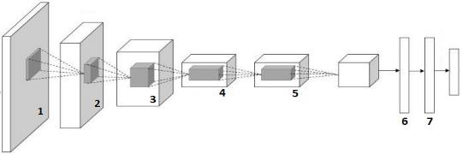
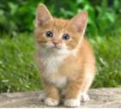
Reconstruct the original image
Pick a layer (the activation)
Forward pass target image until that layer
pool5
[Understanding Deep Image Representations by Inverting Them, Mahendran and Vedaldi, 2014]
Computer Vision

Slide 17
Reconstruct the original image
Optimize zero image/random noise to have the closest distance activation to the target
pool5
Zero Image
pool5
gradient input
[Understanding Deep Image Representations by Inverting Them, Mahendran and Vedaldi, 2014]
Computer Vision

Slide 18
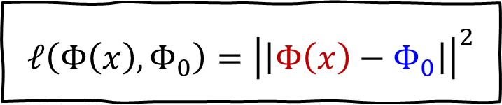

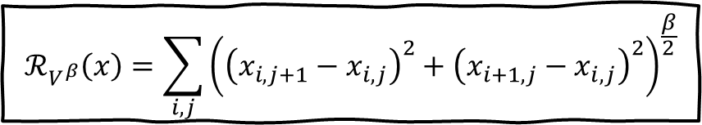
Reconstruct the original image
$$x^{∗}=\underset{x∈ℝ^{HxWxC}}{argmin}{ℓ\left(Φ\left(x\right), { Φ}_{0}\right)+λℛ(x)}$$
$$ℓ\left(Φ\left(x\right), Φ_{0}\right)={\left|\left|Φ\left(x\right)−Φ_{0}\right|\right|}^{2}$$
L2 Loss (feature of new image must match as close as possible to target feature)
$$ℛ_{V^{β}}\left(x\right)=\sum_{i,j}{{\left({\left(x_{i,j+1}−x_{i,j}\right)}^{2}+{\left(x_{i+1,j}−x_{i,j}\right)}^{2}\right)}^{\frac{β}{2}}}$$
Total Variation regularizer (encourages spatial smoothness)
[Understanding Deep Image Representations by Inverting Them, Mahendran and Vedaldi, 2014]
Computer Vision

Slide 19
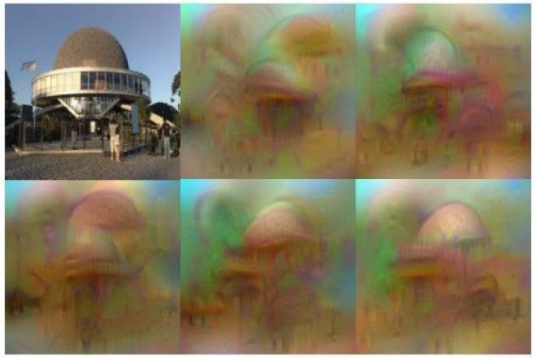
Reconstruction: FC7 layer
Reconstructions from the 1000 log probabilities for ImageNet (ILSVRC) classes
[Understanding Deep Image Representations by Inverting Them, Mahendran and Vedaldi, 2014]
Computer Vision

Slide 20
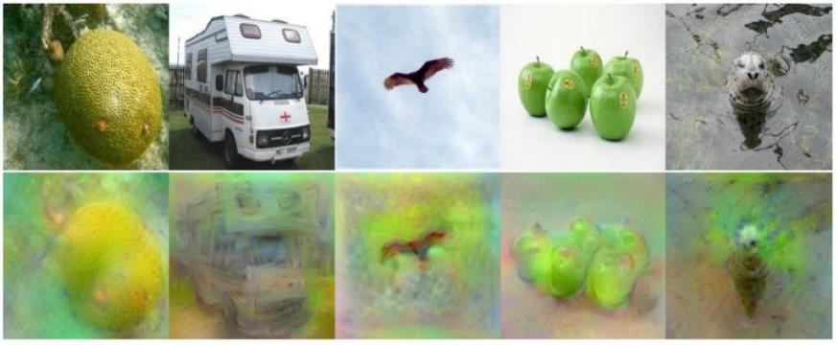
Reconstruction: pool5, before FC1 layer
[Understanding Deep Image Representations by Inverting Them, Mahendran and Vedaldi, 2014]
Computer Vision

Slide 21
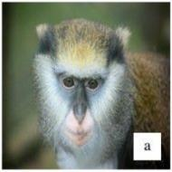
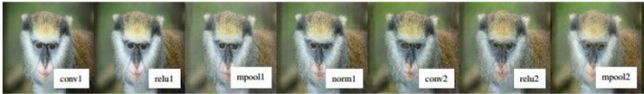
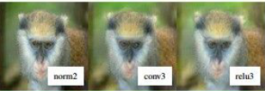
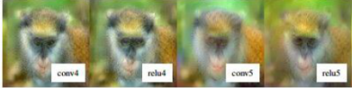
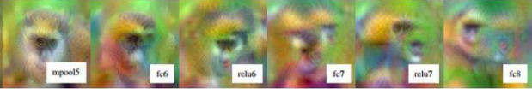
Image Reconstruction (AlexNet)
[Understanding Deep Image Representations by Inverting Them, Mahendran and Vedaldi, 2014]
Computer Vision

Slide 22
Image Reconstruction (VGG16)
Mahendran and Vedaldi, “Understanding Deep Image Representations by Inverting Them”, CVPR 2015
Figure from Johnson, Alahi, and Fei-Fei, “Perceptual Losses for Real-Time Style Transfer and Super-Resolution”, ECCV 2016. Copyright Springer, 2016.
Computer Vision

Slide 23
Texture Synthesis
Computer Vision

Slide 24
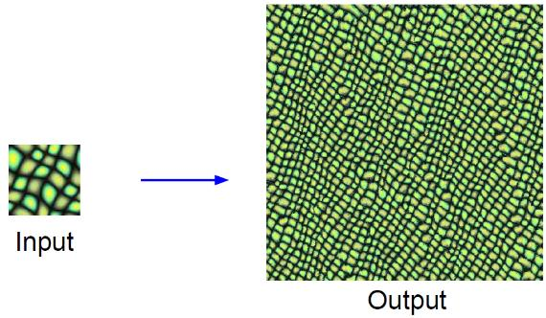
Texture Synthesis
Given a sample patch of some texture, can we generate a bigger image of the same texture?
Computer Vision

Slide 25
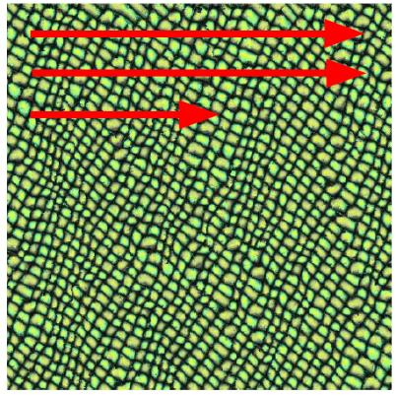
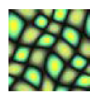
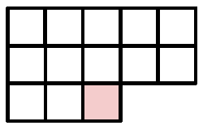
Texture Synthesis: Nearest Neighbor
Generate pixels one at a time in scanline order; form neighborhood of already generated pixels and copy nearest neighbor from input
Wei and Levoy, “Fast Texture Synthesis using Tree-structured Vector Quantization”, SIGGRAPH 2000
Efros and Leung, “Texture Synthesis by Non-parametric Sampling”, ICCV 1999
Computer Vision

Slide 26
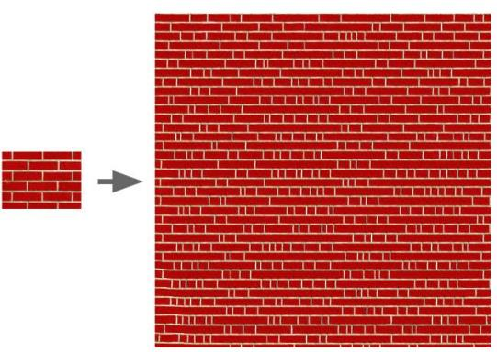
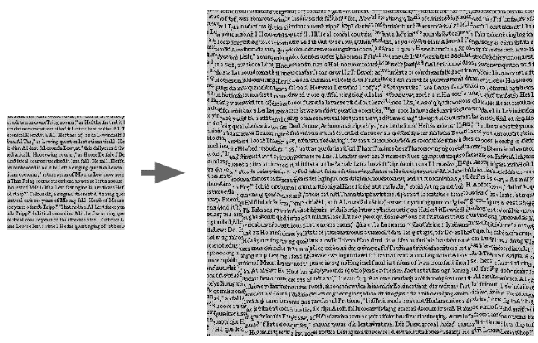
Texture Synthesis: Nearest Neighbor
Works well for simple pattern
But fail on the complex one
Computer Vision

Slide 27
Texture Synthesis with Neural Networks
Computer Vision

Slide 28
Optimize to match the pattern
Similar idea to feature inversion
But we don’t want to match the feature location
What feature in which location ➔ image reconstruction
Instead we want a new and larger image to match the pattern / texture
Define: pattern or texture?
Computer Vision

Slide 29
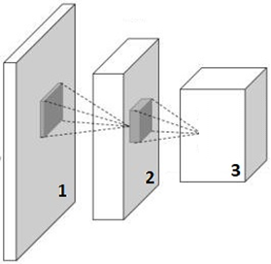
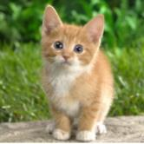
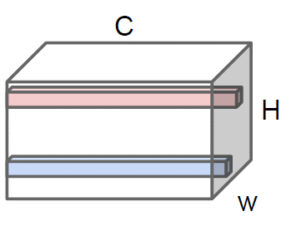
Define: Texture
Relation between feature/pattern
How often a pair of features appear together in one spatial location across the image
Computer Vision

Slide 30
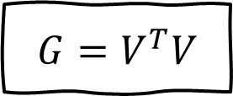
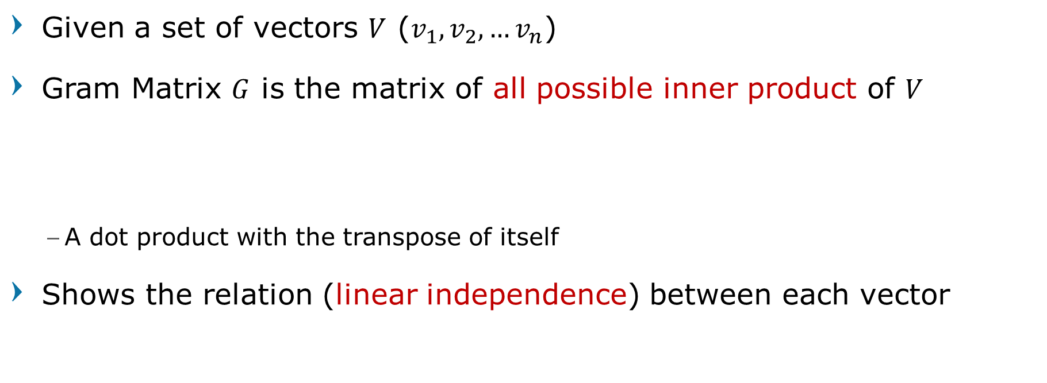
Gramian Matrix
Given a set of vectors $V$ ($v_{1},v_{2},…v_{n}$)
Gram Matrix $G$ is the matrix of all possible inner product of $V$
A dot product with the transpose of itself
Shows the relation (linear independence) between each vector
$$G=V^{T}V$$
Computer Vision

Slide 31

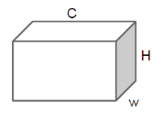
Defining Texture using Gram Matrix
Retrieve activation maps from a layer
Computer Vision

Slide 32
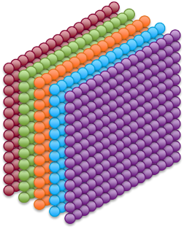
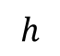
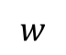
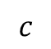
Activation Maps
Each color represents the activations of a filter as it was convolved around an image
$$h$$
$$w$$
$$c$$
Conv3
Computer Vision

Slide 33
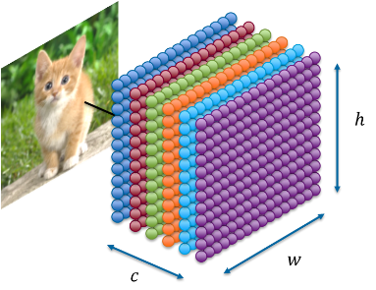
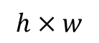
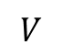
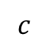
Unrolled Activation $V$
$$h×w$$
$$c$$
$$V$$
Each row represents the activations of a filter
Each column is a combination of activations in the same spatial location
Computer Vision

Slide 34
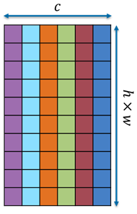
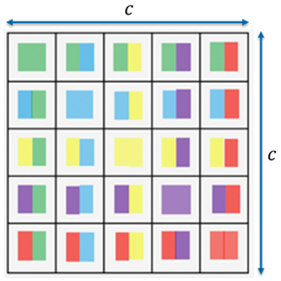
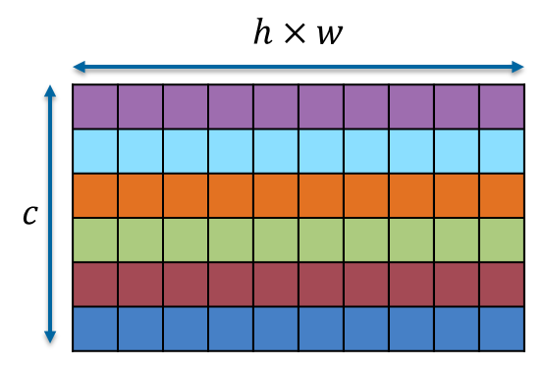


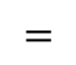
Gram Matrix (Style Matrix)
$$×$$
$$=$$
$$G=V^{T}V$$
Correlation between Filters over spatial locations
(throw away spatial information)
Computer Vision

Slide 35
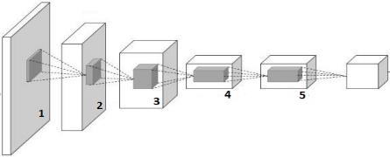
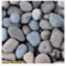
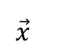
Synthetizing Image (1/4)
Feed input texture
Record activation on every layer, and calculate the gram matrix
$$\vec{x}$$
Computer Vision

Slide 36
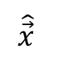
Synthetizing Image (2/4)
Feed generated image from random noise
Record activation on every layer, and calculate the gram matrix
$$\vec{x}$$
Random Image
$$\hat{\vec{x}}$$
Computer Vision

Slide 37
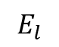

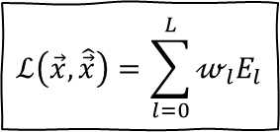
Synthetizing Image (3/4)
Calculate loss $E_{l}$ (L2 distance) for each gram matrix
Calculate total loss $ℒ\left(\vec{x},\hat{\vec{x}}\right)$ using weighted sum
$$\vec{x}$$
$$ℒ\left(\vec{x},\hat{\vec{x}}\right)=\sum_{l=0}^{L}{𝓌_{l}E_{l}}$$
$$E_{l}$$
Random Image
$$\hat{\vec{x}}$$
Computer Vision

Slide 38
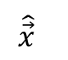
Synthetizing Image (4/4)
Backprop to get gradient image, update image
Repeat until converge
$$\vec{x}$$
$$ℒ\left(\vec{x},\hat{\vec{x}}\right)=\sum_{l=0}^{L}{𝓌_{l}E_{l}}$$
Random Image
$$\hat{\vec{x}}$$
gradient input
Computer Vision

Slide 39
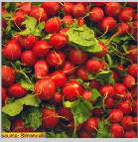







Neural Texture Synthesis
Reconstructing texture from higher layers recovers larger features from the input texture
original
conv1_1
pool1
pool3
Gatys, Ecker, and Bethge, “Texture Synthesis Using Convolutional Neural Networks”, NIPS 2015
Computer Vision

Slide 40








Neural Texture Synthesis
Reconstructing texture from higher layers recovers larger features from the input texture
original
conv1_1
pool1
pool3
Gatys, Ecker, and Bethge, “Texture Synthesis Using Convolutional Neural Networks”, NIPS 2015
Computer Vision

Slide 41

Neural Texture Synthesis
A new image, with the same pattern
not just stitching
Gatys, Ecker, and Bethge, “Texture Synthesis Using Convolutional Neural Networks”, NIPS 2015
Computer Vision

Slide 42
Neural Texture Synthesis: Texture = Artwork ?
Computer Vision

Slide 43

Neural Texture (Artwork) Synthesis:
Texture synthesis (Gram reconstruction)
Computer Vision

Slide 44


Neural Style Transfer: Feature + Gram Reconstruction
Texture synthesis (Gram reconstruction)
Feature reconstruction
Computer Vision

Slide 45
Neural Style Transfer
Computer Vision

Slide 46



Neural Style Transfer
Combine Content of Image A and Style from Image B
Image A
Content target
Image B
Style target
Image C
Content A + Style B
[Neural Algorithm of Artistic Style by Leon A. Gatys, Alexander S. Ecker, and Matthias Bethge, 2015]
Computer Vision

Slide 47


Neural Style Transfer: step-by-step
Step 1: feed content image, extract the activation map
from some earliest layers
content
activations
[Neural Algorithm of Artistic Style by Leon A. Gatys, Alexander S. Ecker, and Matthias Bethge, 2015]
Computer Vision

Slide 48

Neural Style Transfer: step-by-step
Step 2: feed style image, extract the gram matrices
from several layers
style
gram matrix
[Neural Algorithm of Artistic Style by Leon A. Gatys, Alexander S. Ecker, and Matthias Bethge, 2015]
Computer Vision

Slide 49
Neural Style Transfer: step-by-step
Step 3: feed random noise, optimize to minimize the distance
of content activation and style gram matrices
content
activations
zero Image
style
matrix
style
matrix
style
matrix
Computer Vision

Slide 50

Neural Style Transfer: step-by-step
[Neural Algorithm of Artistic Style by Leon A. Gatys, Alexander S. Ecker, and Matthias Bethge, 2015]
Computer Vision

Slide 51

Neural Style Transfer: step-by-step
[Neural Algorithm of Artistic Style by Leon A. Gatys, Alexander S. Ecker, and Matthias Bethge, 2015]
Computer Vision

Slide 52

Computer Vision

Slide 53






Neural Style Transfer
[Neural Algorithm of Artistic Style by Leon A. Gatys, Alexander S. Ecker, and Matthias Bethge, 2015]
Computer Vision

Slide 54
Playing with Neural Style Transfer
Computer Vision

Slide 55

Style Transfer: Total Loss
Optimize over image to have:
the content of the content image (activations match content)
the style of the style image (gram matrices of activations match style)
Total Loss = weighted sum of all L2 distance
$$ℒ_{total}\left(\vec{p},\vec{a},\vec{x}\right)=αℒ_{content}\left(\vec{p}, \vec{x}\right)+βℒ_{style}\left(\vec{a},\vec{x}\right)$$
Computer Vision

Slide 56
Playing with Neural Style Transfer
more weight to content loss
more weight to style loss
[Neural Algorithm of Artistic Style by Leon A. Gatys, Alexander S. Ecker, and Matthias Bethge, 2015]
Computer Vision

Slide 57

Playing with Neural Style Transfer
Resizing style image before running style transfer
algorithm can transfer different types of features
Larger
style image
Smaller
style image
[Neural Algorithm of Artistic Style by Leon A. Gatys, Alexander S. Ecker, and Matthias Bethge, 2015]
Computer Vision

Slide 58
Multiple Style Images
Mix style from multiple images by taking a weighted average of Gram matrices
Computer Vision

Slide 59

Anime/Manga Neural Style Transfer
Illustration2Vec: A Semantic Vector Representation of Illustrations.
Masaki Saito(Tohoku University) and Yusuke Matsui (University of Tokyo)
Computer Vision

Slide 60


Computer Vision

Slide 61

Computer Vision

Slide 62
Better Results
Computer Vision

Slide 63

Fast Neural Style Transfer
Style transfer requires many forward/backward passes through VGG; very slow!
Solution: Train another neural net to perform style transfer!
[Johnson, Alahi, and Fei-Fei, “Perceptual Losses for Real-Time Style Transfer and Super-Resolution”, ECCV 2016]
Computer Vision

Slide 64

Fast Neural Style Transfer
Implemented in production by many big company
Runs on smartphone
[Johnson, Alahi, and Fei-Fei, “Perceptual Losses for Real-Time Style Transfer and Super-Resolution”, ECCV 2016]
Computer Vision

Slide 65
Better Result with Instance Normalization
Replacing batch normalization with Instance Normalization improves results
[Ulyanov et al, “Texture Networks: Feed-forward Synthesis of Textures and Stylized Images”, ICML 2016]
[Ulyanov et al, “Instance Normalization: The Missing Ingredient for Fast Stylization”, arXiv 2016]
Computer Vision

Slide 66
One Network, Many Styles
One network per style is a downside
Train a network that can generate any style by feeding a condition to chose what style to generate
[Dumoulin, Shlens, and Kudlur, “A Learned Representation for Artistic Style”, ICLR 2017.]
Computer Vision

Slide 67
One Network, Many Styles
Use the same network for multiple styles using conditional instance normalization
Single network can blend styles after training
[Dumoulin, Shlens, and Kudlur, “A Learned Representation for Artistic Style”, ICLR 2017.]
Computer Vision

Slide 68
Summary
Many methods for understanding CNN representations
Activations:
Nearest neighbors, Dimensionality reduction, maximal patches, occlusion
Gradients:
Saliency maps, class visualization, fooling images, feature inversion
Fun:
DeepDream, Style Transfer
Computer Vision

Slide 69

Break, Question?
Computer Vision

